Slide 1

Data Analysis Intern- Task2: YouTube Song Analysis
By: Suzy Adel Wahba Abdelshahid

Slide 2
01
Introduction
Task requirements & my steps to preform the task

Slide 3
Task Breakdown
In this project, I will use Power BI to analyze the YouTube songs dataset. This will help me develop my data analysis and visualization skills in a practical context.
Skills obtained:
Data Cleaning and Preparation Exploratory
Data Analysis (EDA)
Content and Channel Analysis
Temporal Trends Analysis User
Engagement Insights Creating
Interactive Dashboards Generating
These skills are essential for organizing, analyzing, and visualizing data efficiently in various analytical tasks.

Slide 4
My Data Analysis Process
Exploratory data, understanding data types and what each attribute represents
Power BI visuals are used to analyze and manipulate data to derive insights.
Introduction
Analysis
Methodology
Conclusion
Prepare strategic relationships and visualizations that can be created
Involves creating views or temporary tables to organize and summarize data in a format suitable for reporting

Slide 5
02
Results
Question analysis response and Explanation

Slide 6
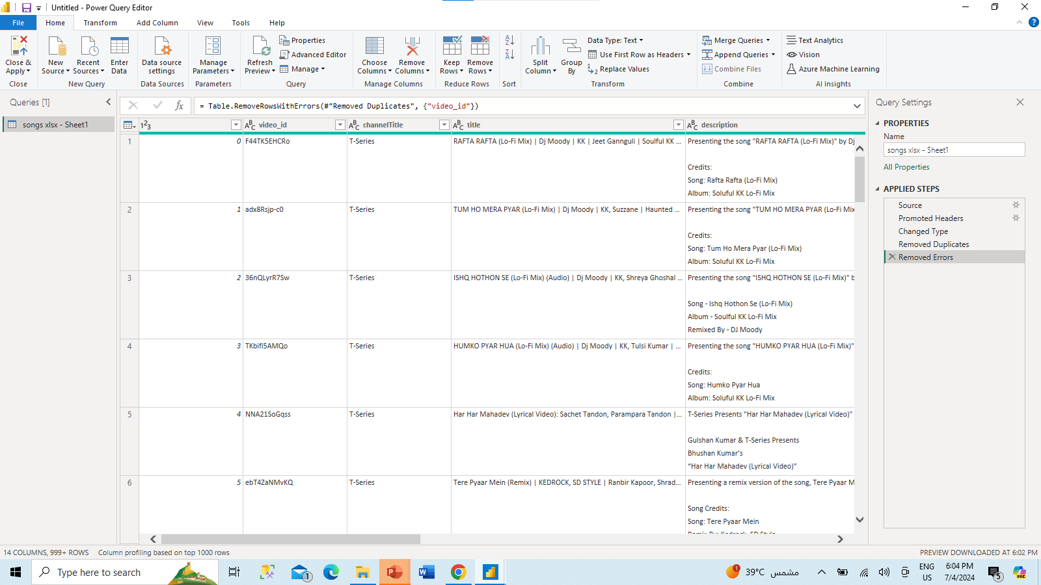
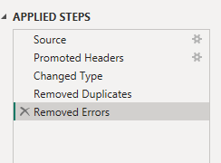
1. Data Cleaning and Preparation
Removed errors in the coloumns.
Ensuring that the dataset is accurate, complete, and ready for analysis, which is crucial for deriving valid insights
Clean and preprocess the dataset, handling missing values or outliers.

Slide 7
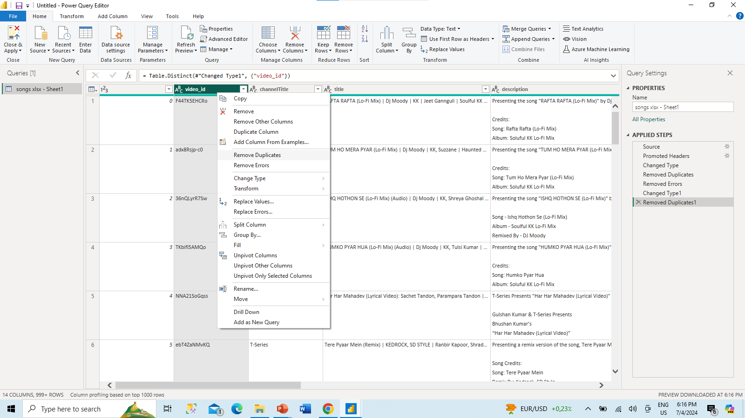
Removed duplicates in video_id, as it should be a unique identifier .

Slide 8
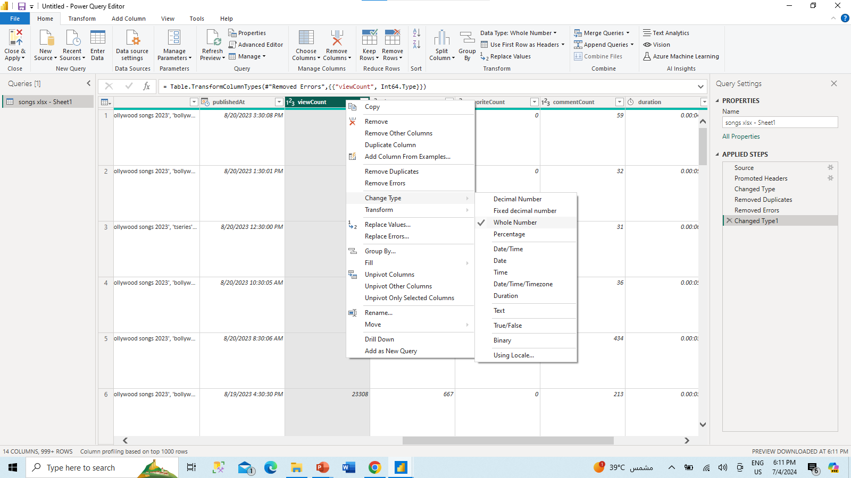
Changed the data types ex. "Date/Time" for publishedAt and "Whole Number" for numerical columns like viewCount, likeCount” to ensure that the data correct data type to be able to use in the tabular vales
Convert relevant columns to appropriate data types..

Slide 9
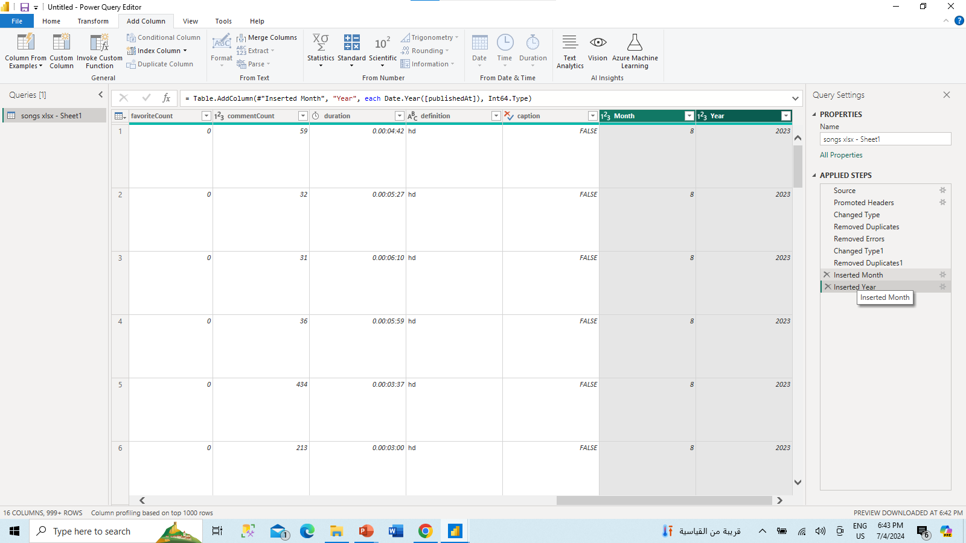
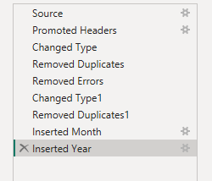
creating new relevant columns, to allow more filtering options rather the full date but just by year or month .

Slide 10
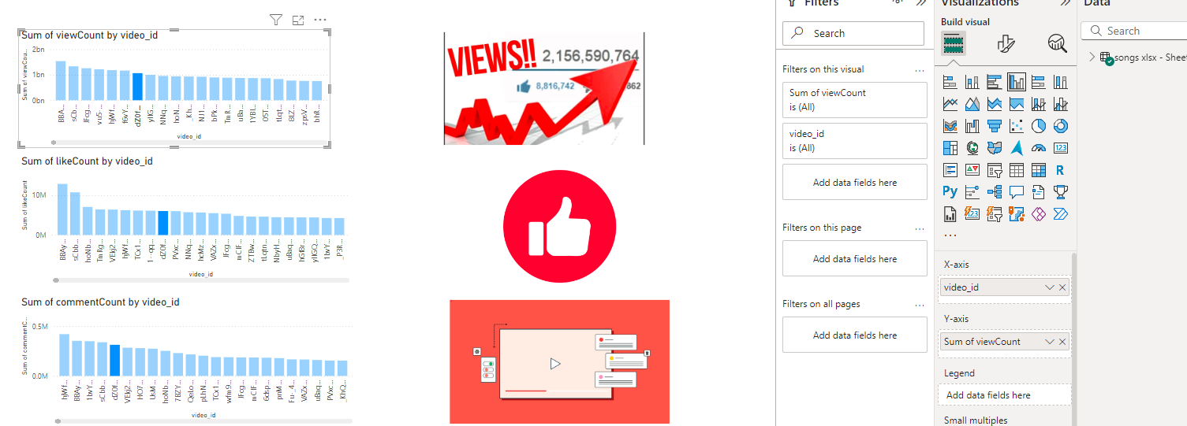
2. Exploratory Data Analysis (EDA)
EDA involves summarizing the main characteristics of the dataset, often using visual methods.
Explore patterns and distributions in view counts, like counts, and comments.

Slide 11
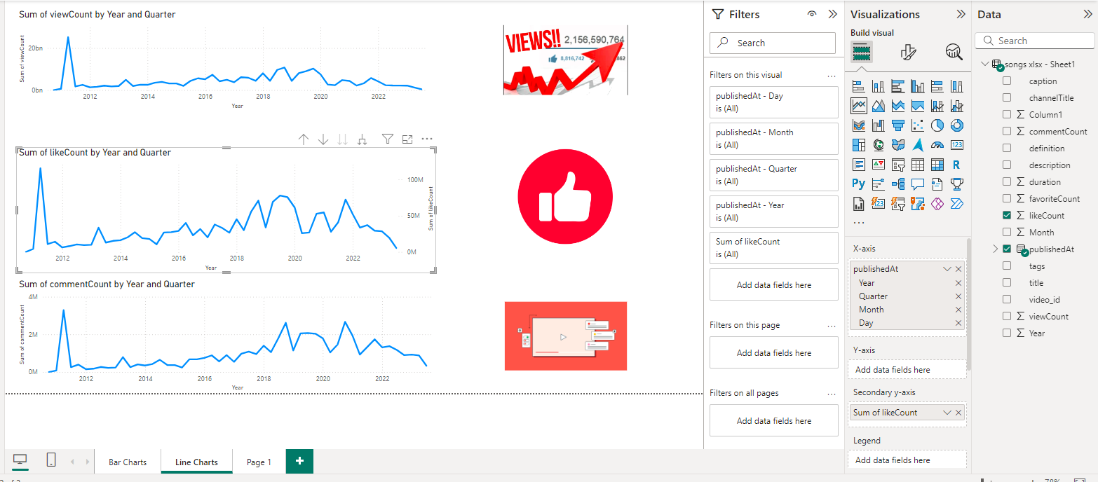
This step includes creating histograms, bar charts, and line charts to understand the distribution and trends in the data.
Identify trends in the popularity and engagement of YouTube song videos.

Slide 12
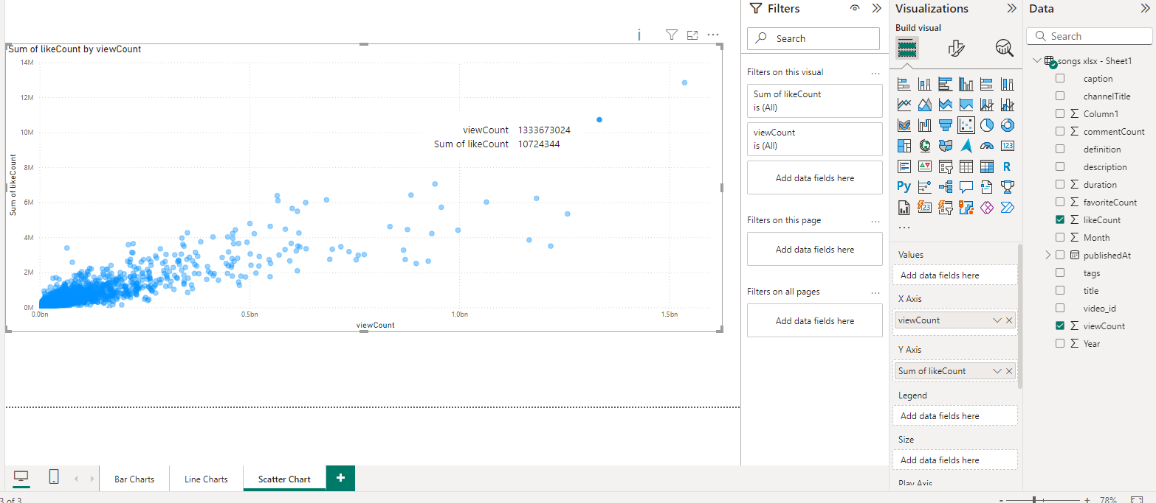
This helps in identifying patterns, trends, and anomalies in the data, providing a better understanding of the dataset.

Slide 13
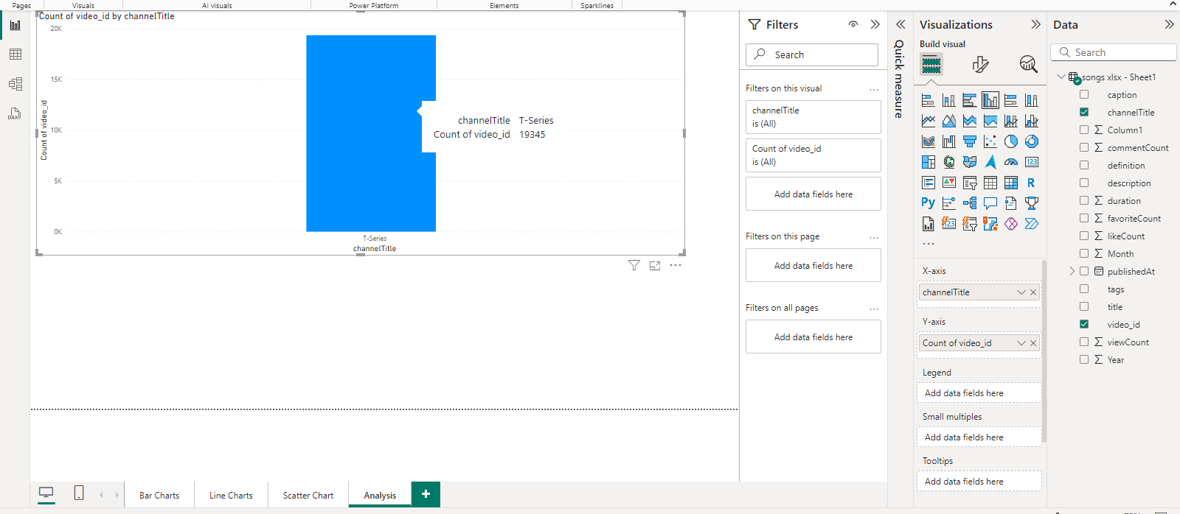
3. Content and Channel Analysis
This figure displays the count of videos for each channel, or to show the number of videos associated with each tag.
There is one channel called “T-series” with 19,345 videos
Analyze the distribution of videos across different channels.

Slide 14
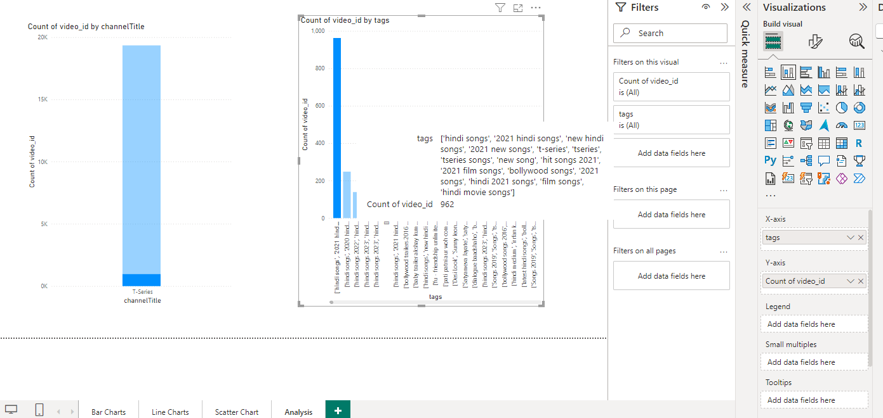
Identify popular tags and their correlation with view counts..

Slide 15
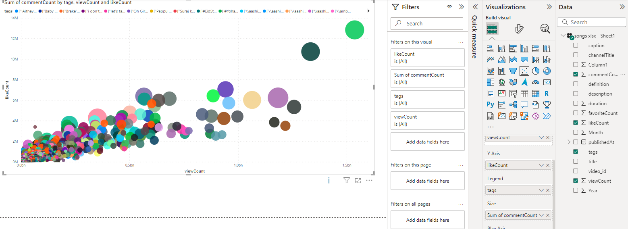
This will plot each tag's correlation between views and likes
The will size the data points based on the number of comments
Notes:
.

Slide 16
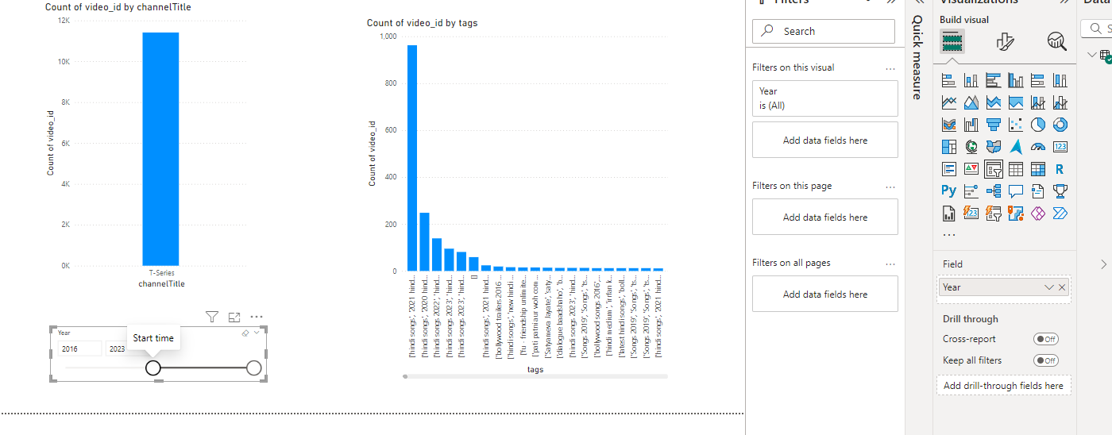
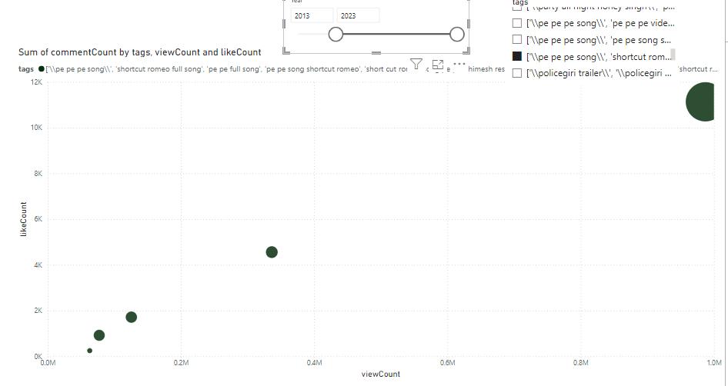
4.Temporal Trends Analysis
Added interactivity, select "Slicer" from the "Visualizations" pane and drag fields such as "publishedAt" or "tags" to the slicer, enabling users to filter the data by date or tags.
This is added to the previous visualize to be able to get meaningful data according to new criteria
Interactive Power BI dashboards showcasing visualizations of YouTube song data trends.
Notes:
rag commentCount to the Size field.This will size the data points based on the number of comments.

Slide 17
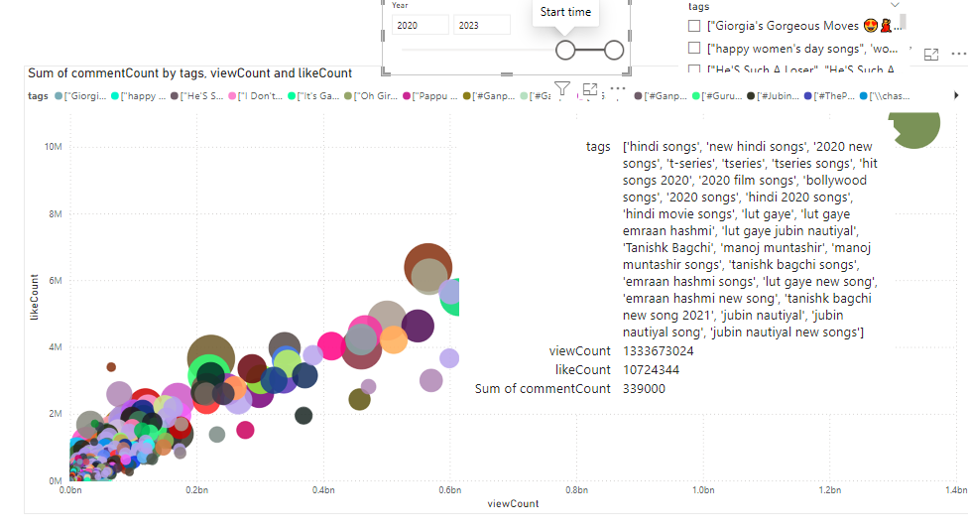
5. User Engagement Insights
These are the most popular tags, as well as the most liked, most commented, and top viewed videos from 2021 to 2023.
The visualization shows the highest likes on the vertical scale, the largest circles for the most comments, and the farthest left on the horizontal scale for the most views.
To conclude the more the views the higher likes and more comments this is seen as the points are increasing more or less linearly
Investigate relationships between likes, comments, and views.

Slide 18
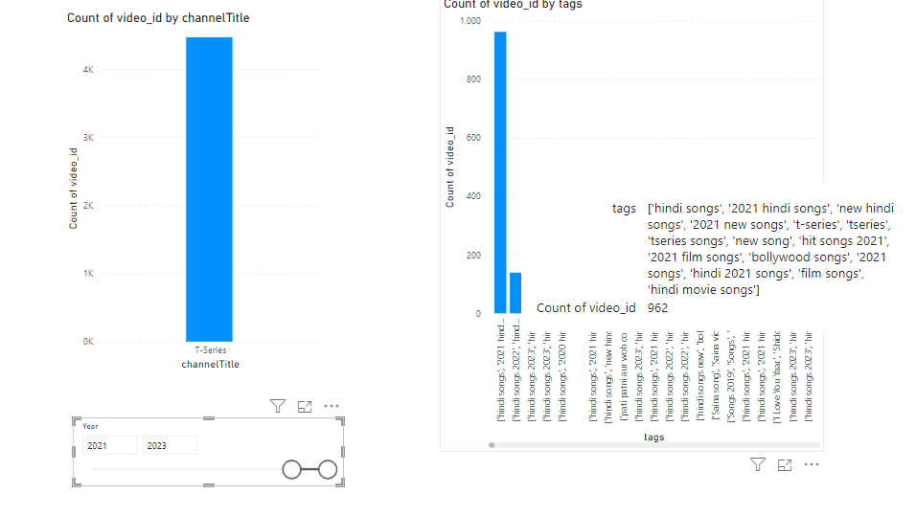
This representation shows that there are a lot of videos with tags, and the more tags the more views and likes
Identify factors influencing user engagement with YouTube song videos..

Slide 19
Conclusion

Slide 20
Thanks!
Do you have any questions?
suzyadel37@gamil.com
01204407191
www.mentorness.com

